Slide 1
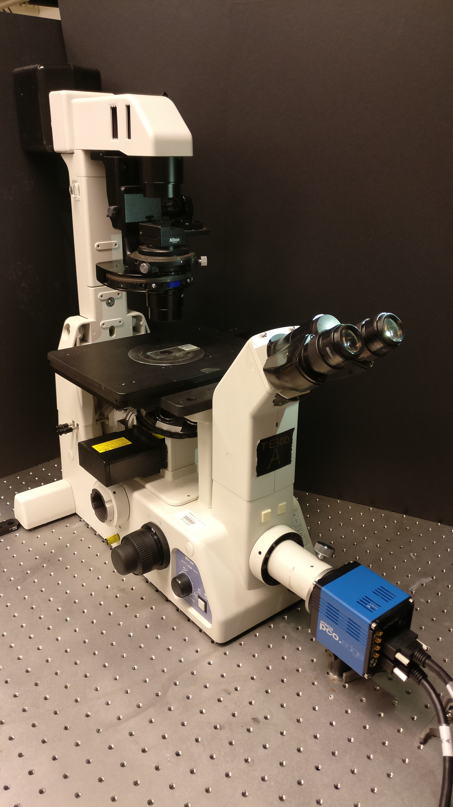
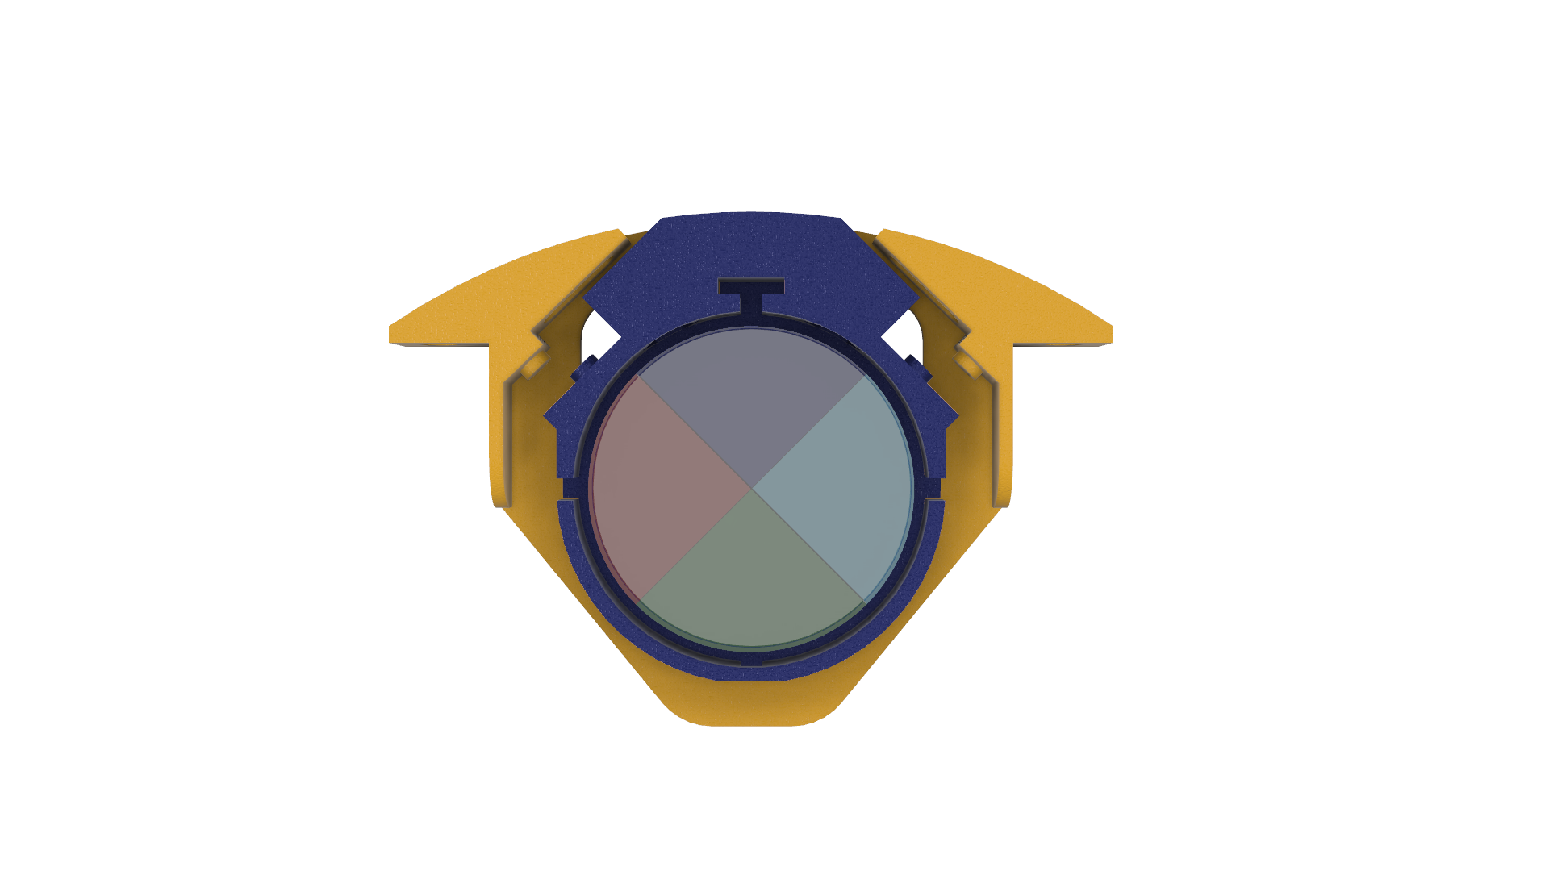
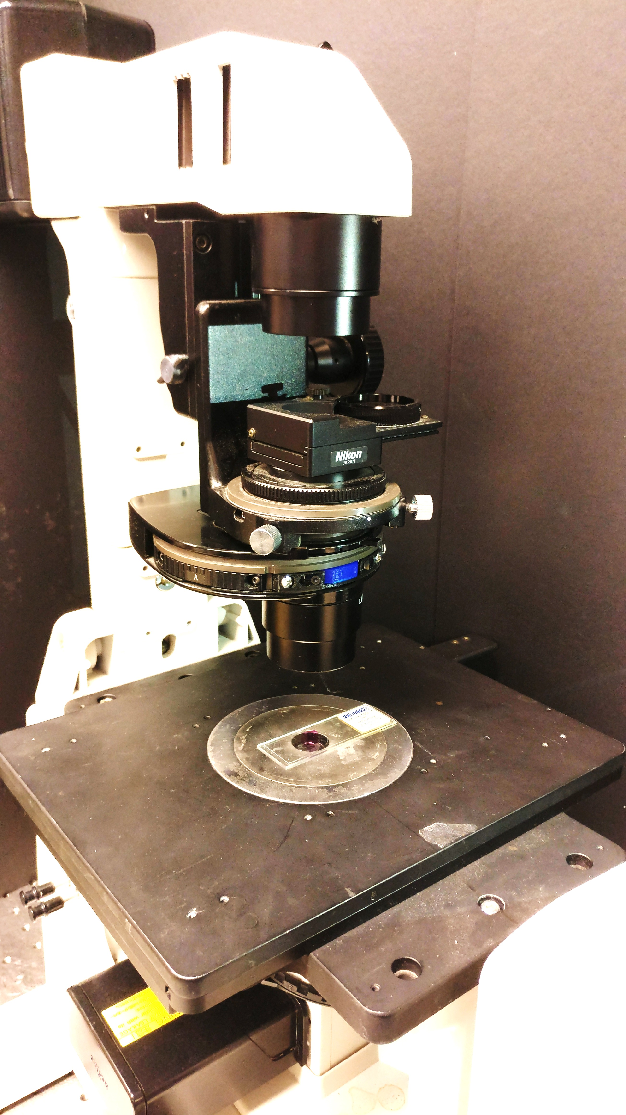
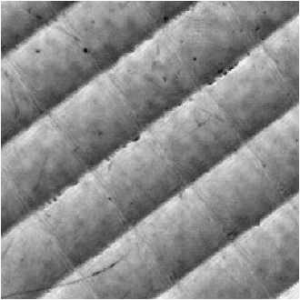
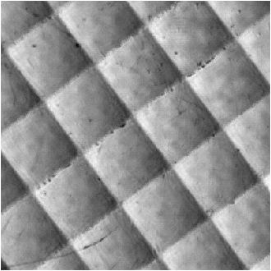
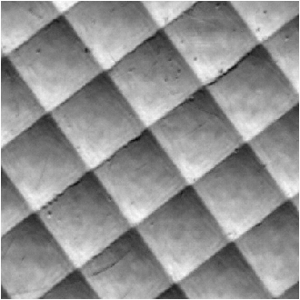
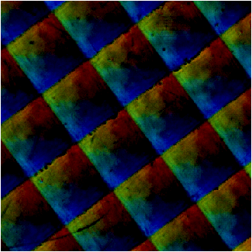
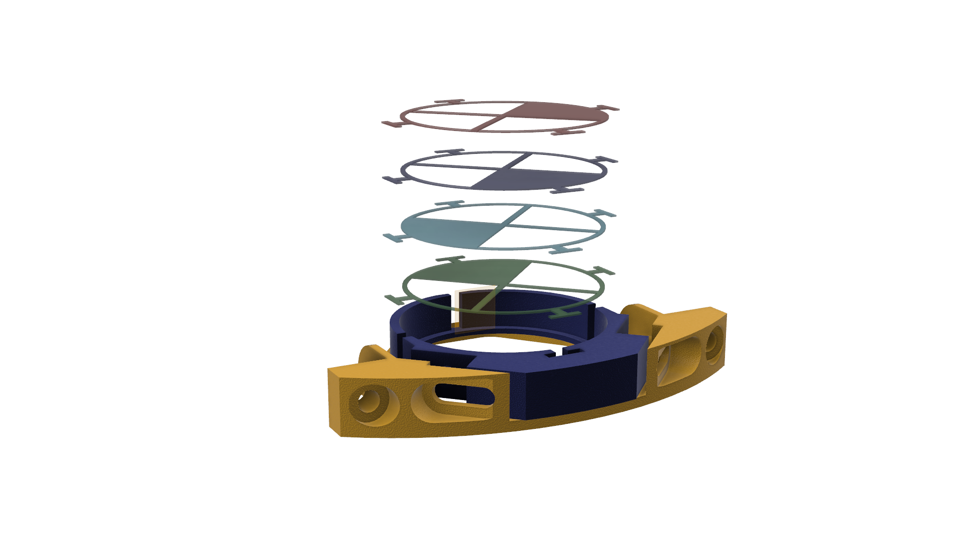
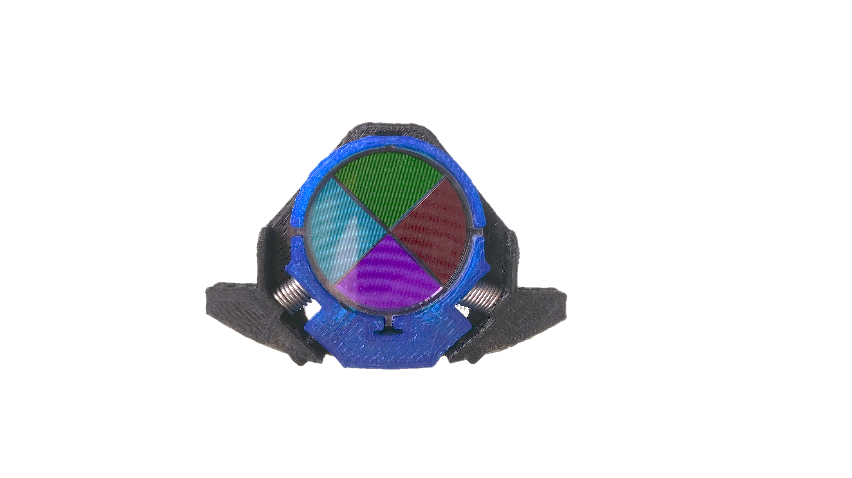
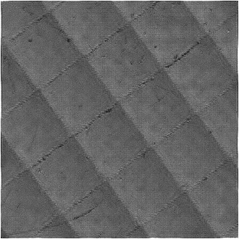

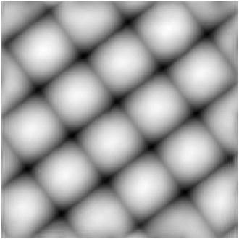
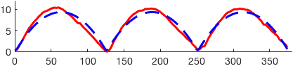
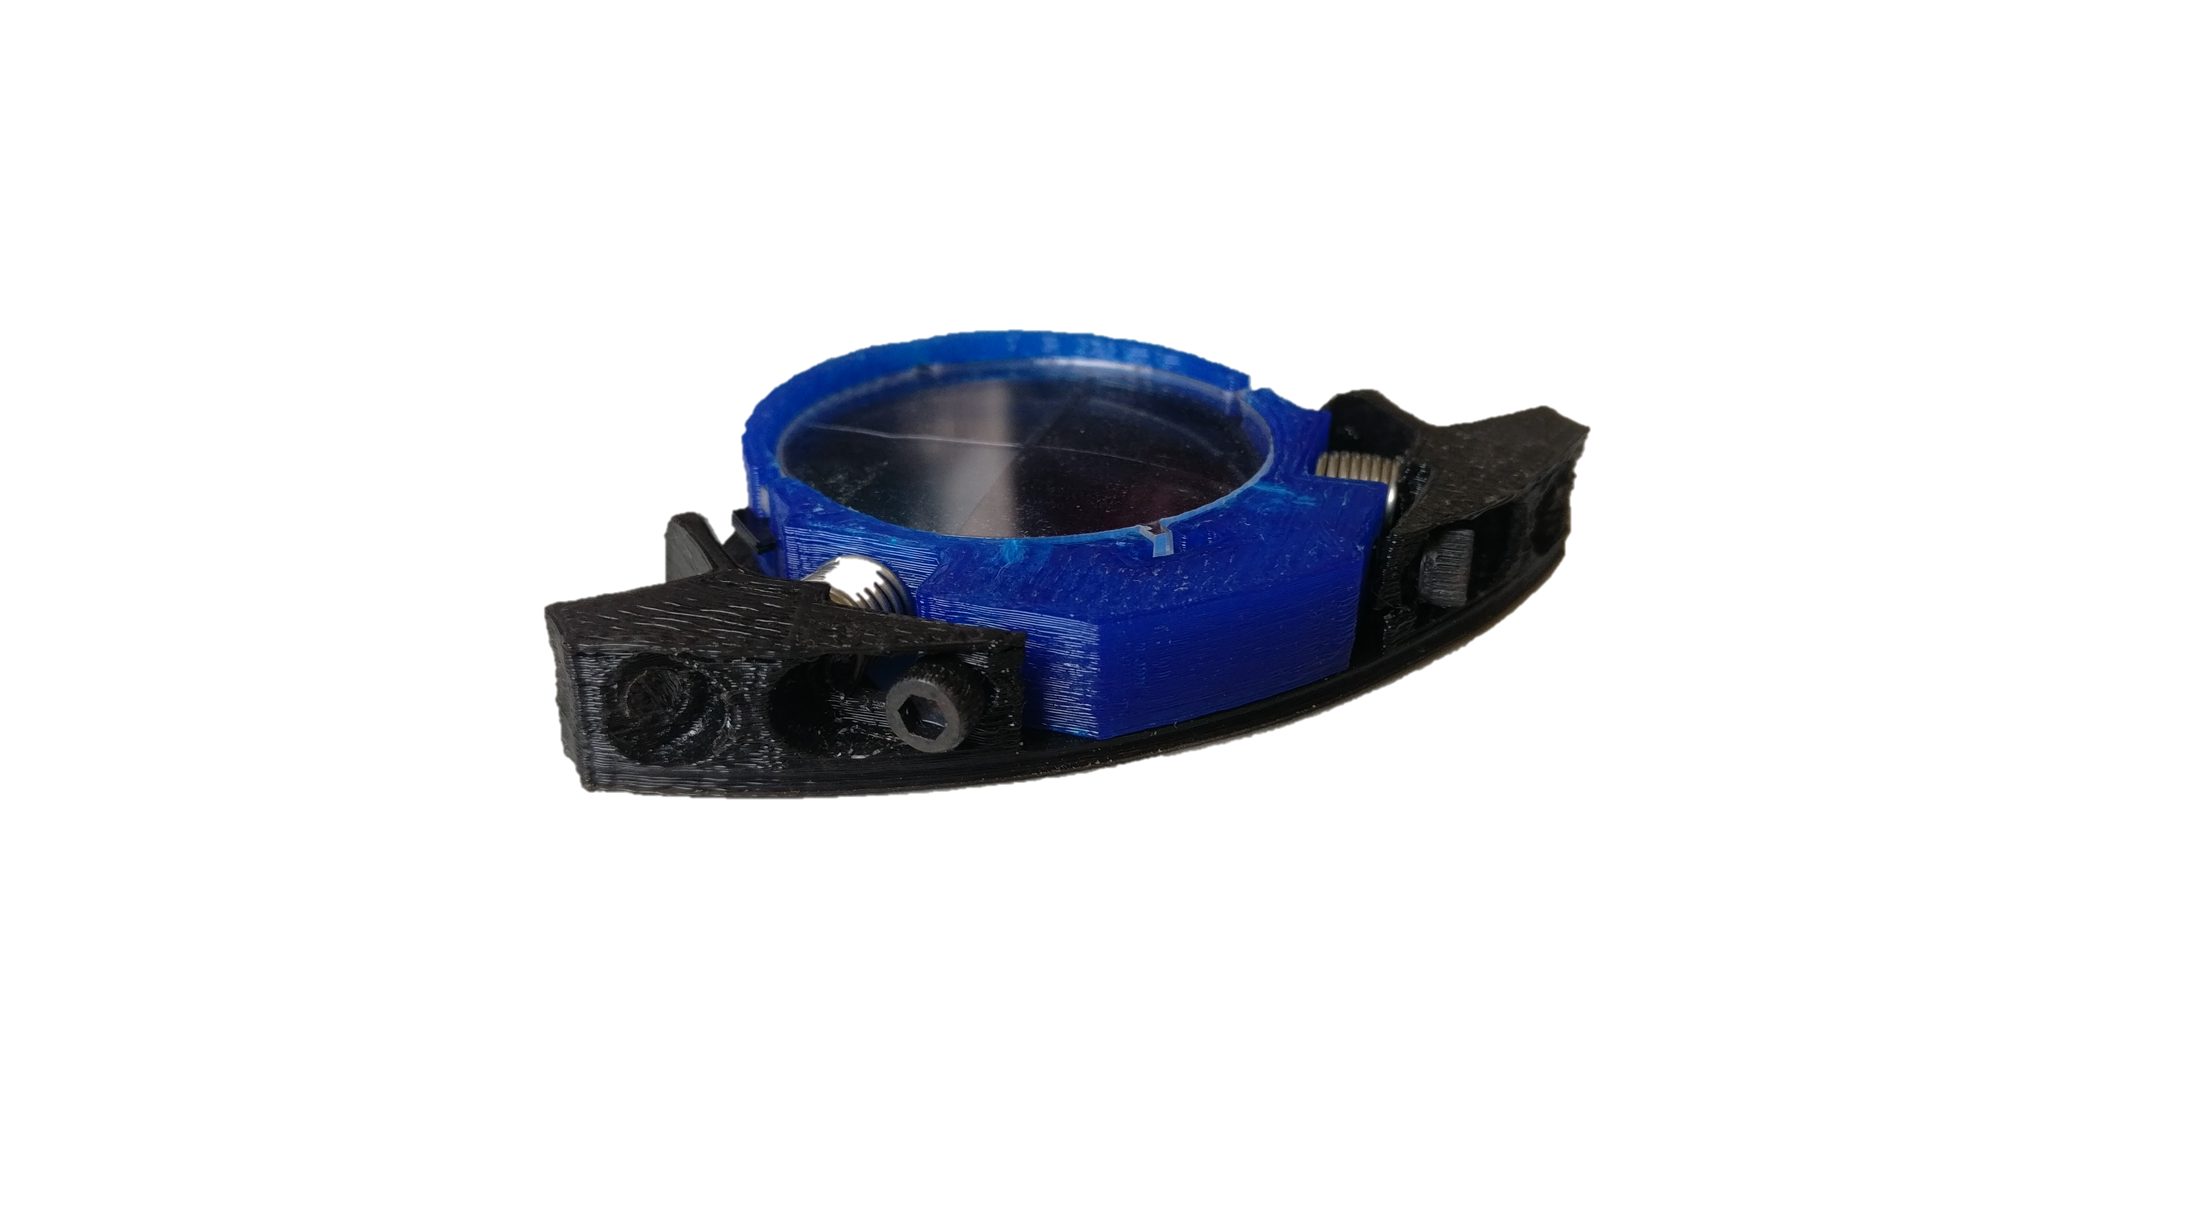
a)
c)
Existing Microscope
Existing Illumination Pathway
Sample
Broadband
Lamp
cDPC
Filter
Condenser
Lens
Objective
Lens
Tube
Lens
Color
Camera
d)
Red Channel
Green Channel
Blue Channel
b)
cDPC Algorithm
Demosaiced Image
Absorption (a.u)
1.6
Phase (radians)
14
Phase Cutline
Phase (rad)
Position (μm)
Measured
Quantitative Amplitude and Phase
Expected
Rendering
Prototype
Phase Contrast
0.6
0
c.)

Slide 2
14
rad
0
Quantitative
Phase
Filter
Image

Slide 3
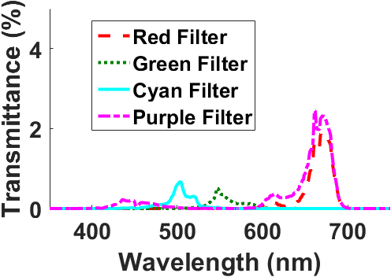
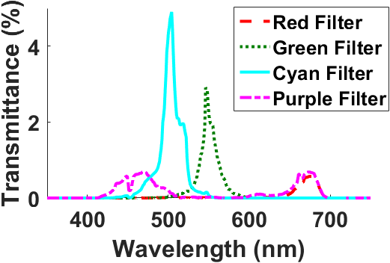
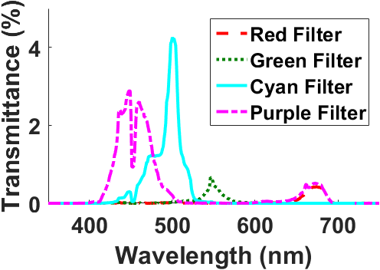


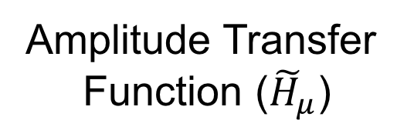
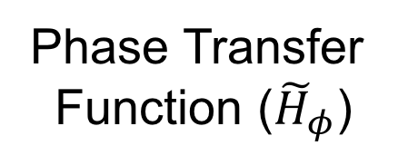
Signal Spectrum After Bayer Filter
Amplitude Transfer
Function (${\tilde{H}}_{μ}$)
Phase Transfer
Function (${\tilde{H}}_{φ}$)
Source
Red
$k_{y}$
$$k_{x} (μm^{−1})$$
Green
Blue
a.u.
a.u.

Slide 4
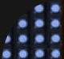
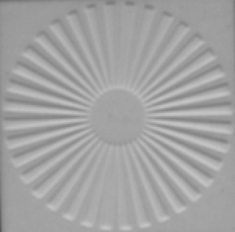
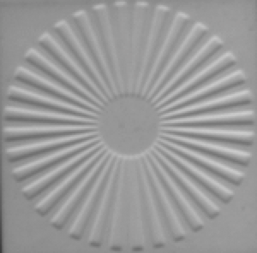
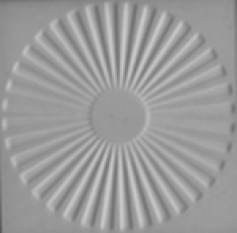
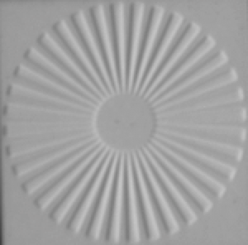
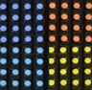
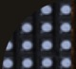
Source
Raw Camera Measurements
Recovered Optical Field
1.5
3.0
Through-focus
(14 Images)
*Nonlinear
spacing
Coherent
Source
20µm
20µm
Z = -31μm
Z = 0μm
Z = 31μm
Amplitude
0.5
Phase (rad)
0.0
1.5
3.0
Monochromatic
DPC (4 Images)
LED Array
20µm
0.5
20µm
0.0
Top
Bottom
Right
Left
Amplitude
Phase (rad)
1.5
3.0
cDPC (ours)
(1 Image)
Color LED Array
Red Channel
Green Channel
Blue Channel
20µm
0.5
20µm
0.0
RGB
Amplitude
Phase (rad)

Slide 5
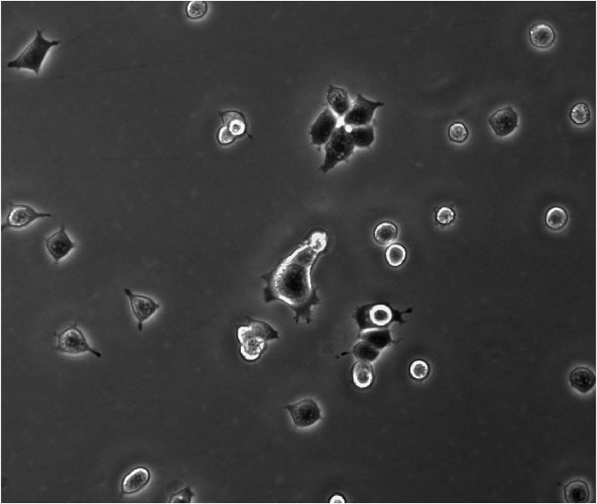
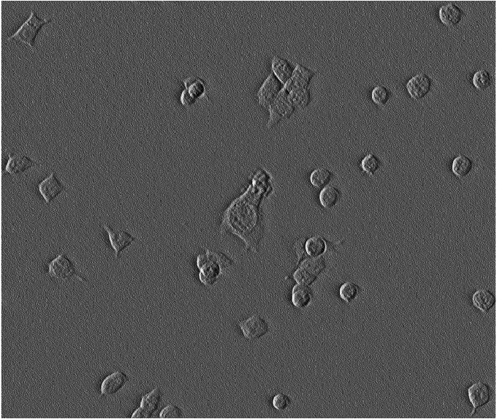
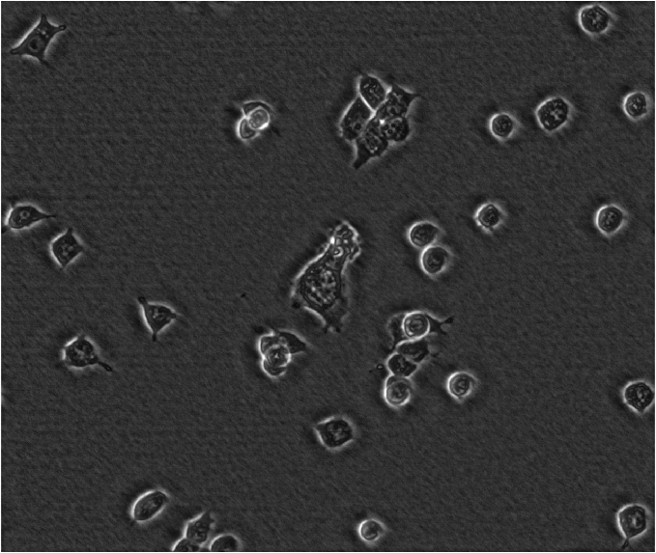
Phase Contrast + DIC Comparison
Differential Interference Contrast
Phase Contrast
Ground Truth
100μm
*20x,0.75NA
100μm
Synthesized
100μm
100μm
HEK293 Cells (20x, 0.4NA)
SCALE BARS
Notes:
Scale bars

Slide 6
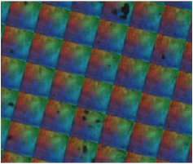
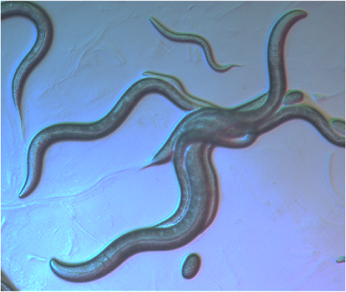
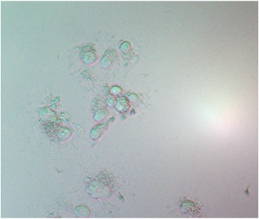
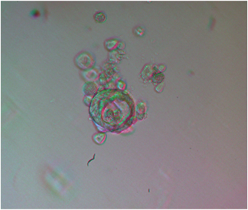
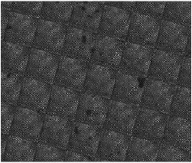
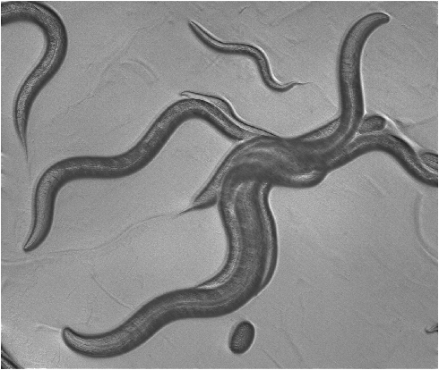
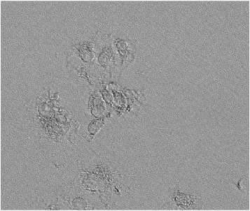
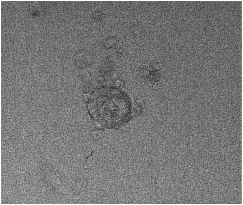

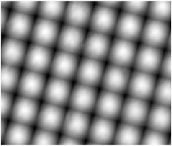
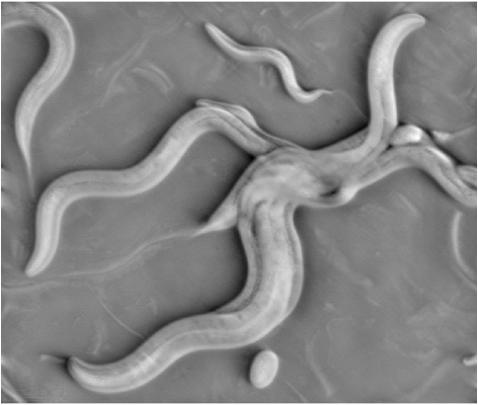
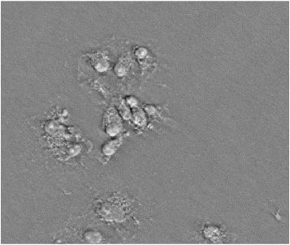
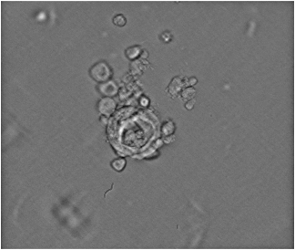
Micro-Lens Array
4x / 0.1NA
c. elegans
10x / 0.25NA
COS7 Cells
20x / 0.4NA
MCF7 Cells
20x / 0.4NA
RGB Composite
Raw Images
200 μm
200μm
50μm
50μm
1.4
1.3
1.1
1.2
Amplitude (a.u)
Recovered Complex Field
0.7
0.7
0.9
1.0
16
23
2.7
3.7
Phase (rad)
0
0
0
0
Notes:
Colorbars
BGS contrast

Slide 7
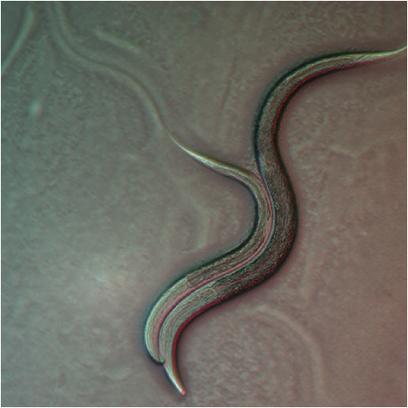
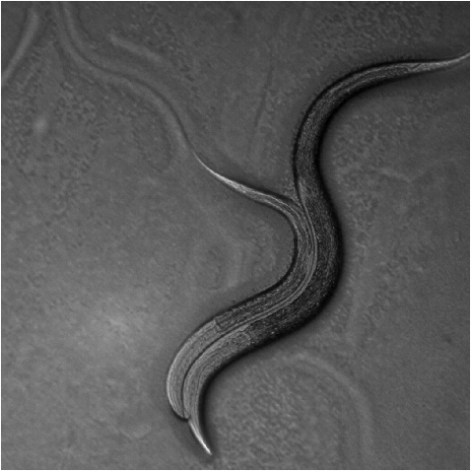
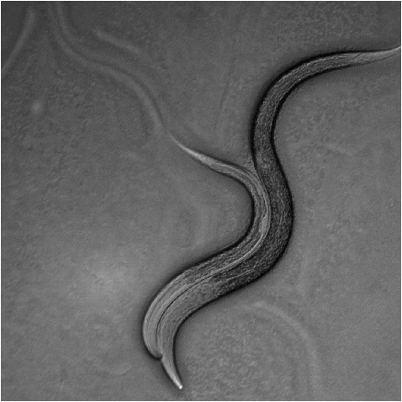
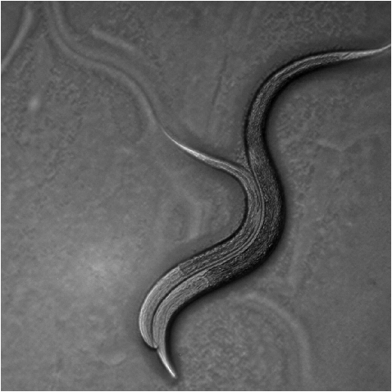
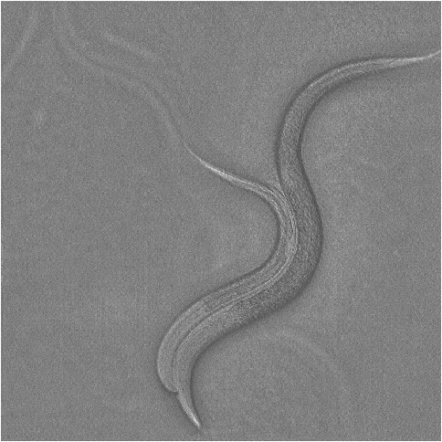
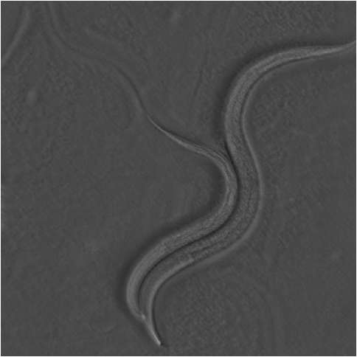
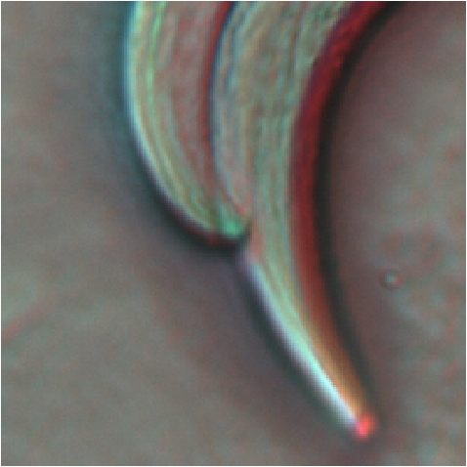
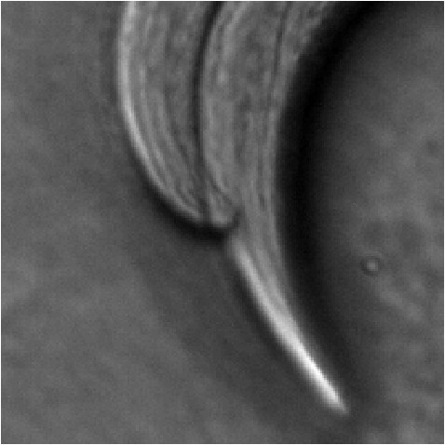
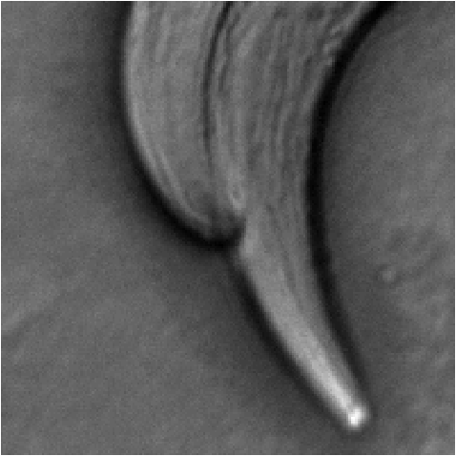
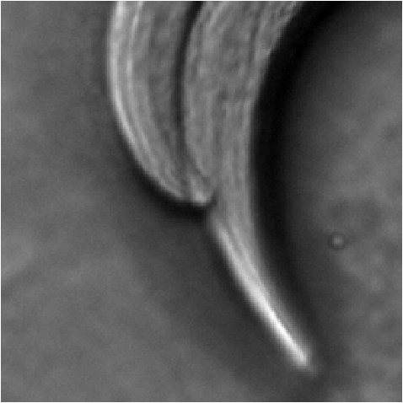


Raw Data
Results
Top
Bottom
Right
Left
a.u.
Radians
100𝜇m
100𝜇m
100𝜇m
100𝜇m
Amp
Phase
RGB
Red
Green
Blue
a.u.
Radians
100𝜇m
100𝜇m
100𝜇m
100𝜇m
Amp
Phase

